Slide 1
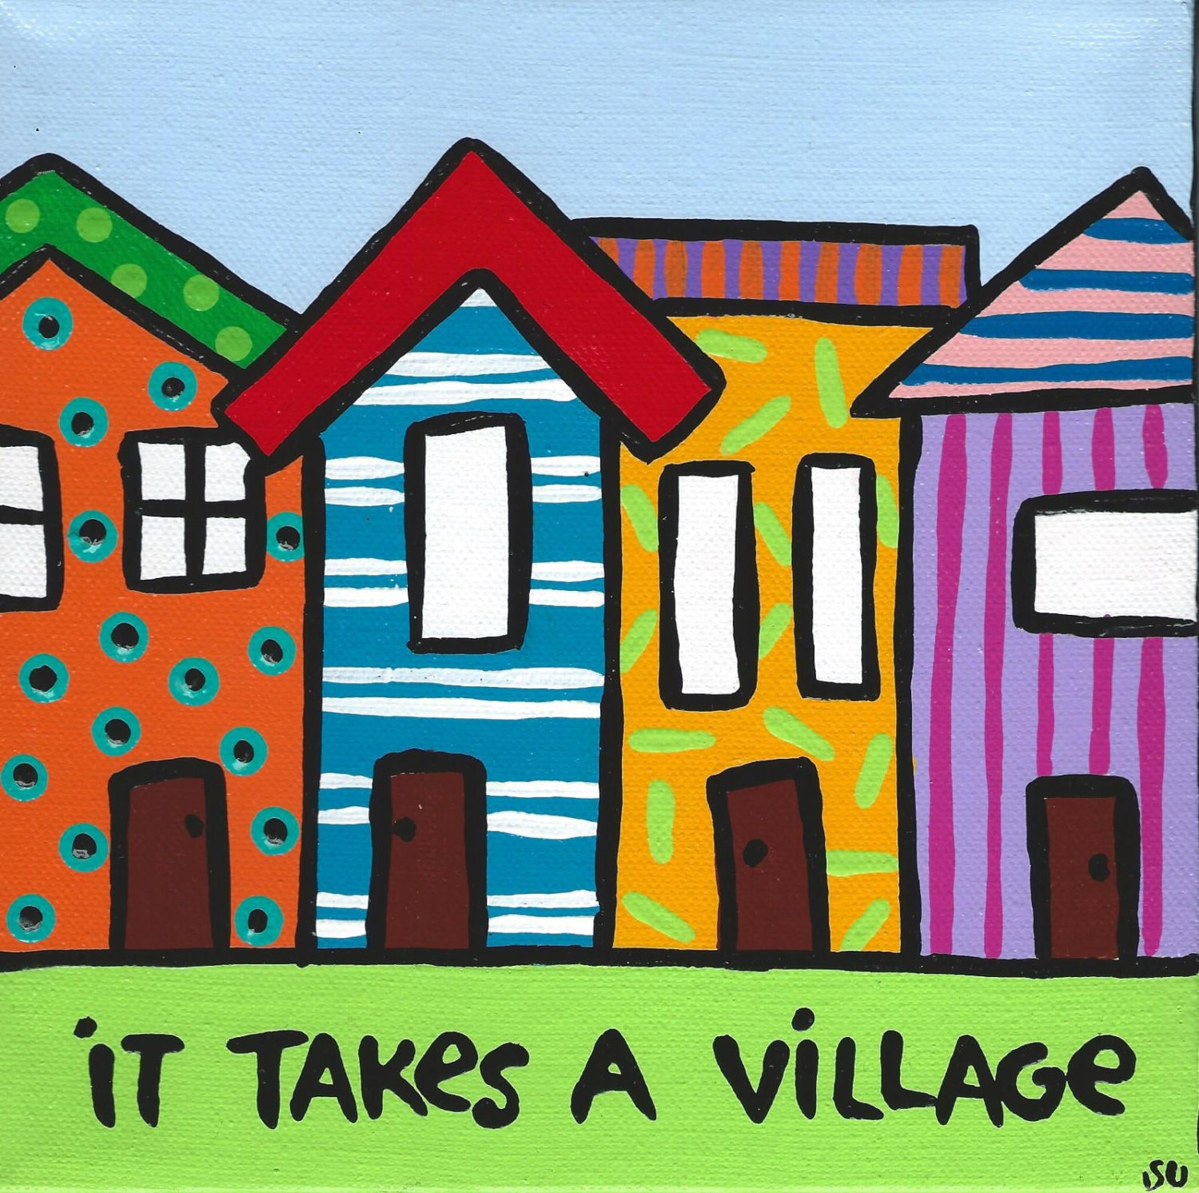
Holly K. Shaw, PhD, RN
May 5, 2022

Slide 2
Mental Health and Aging
Global Perspectives

Slide 3
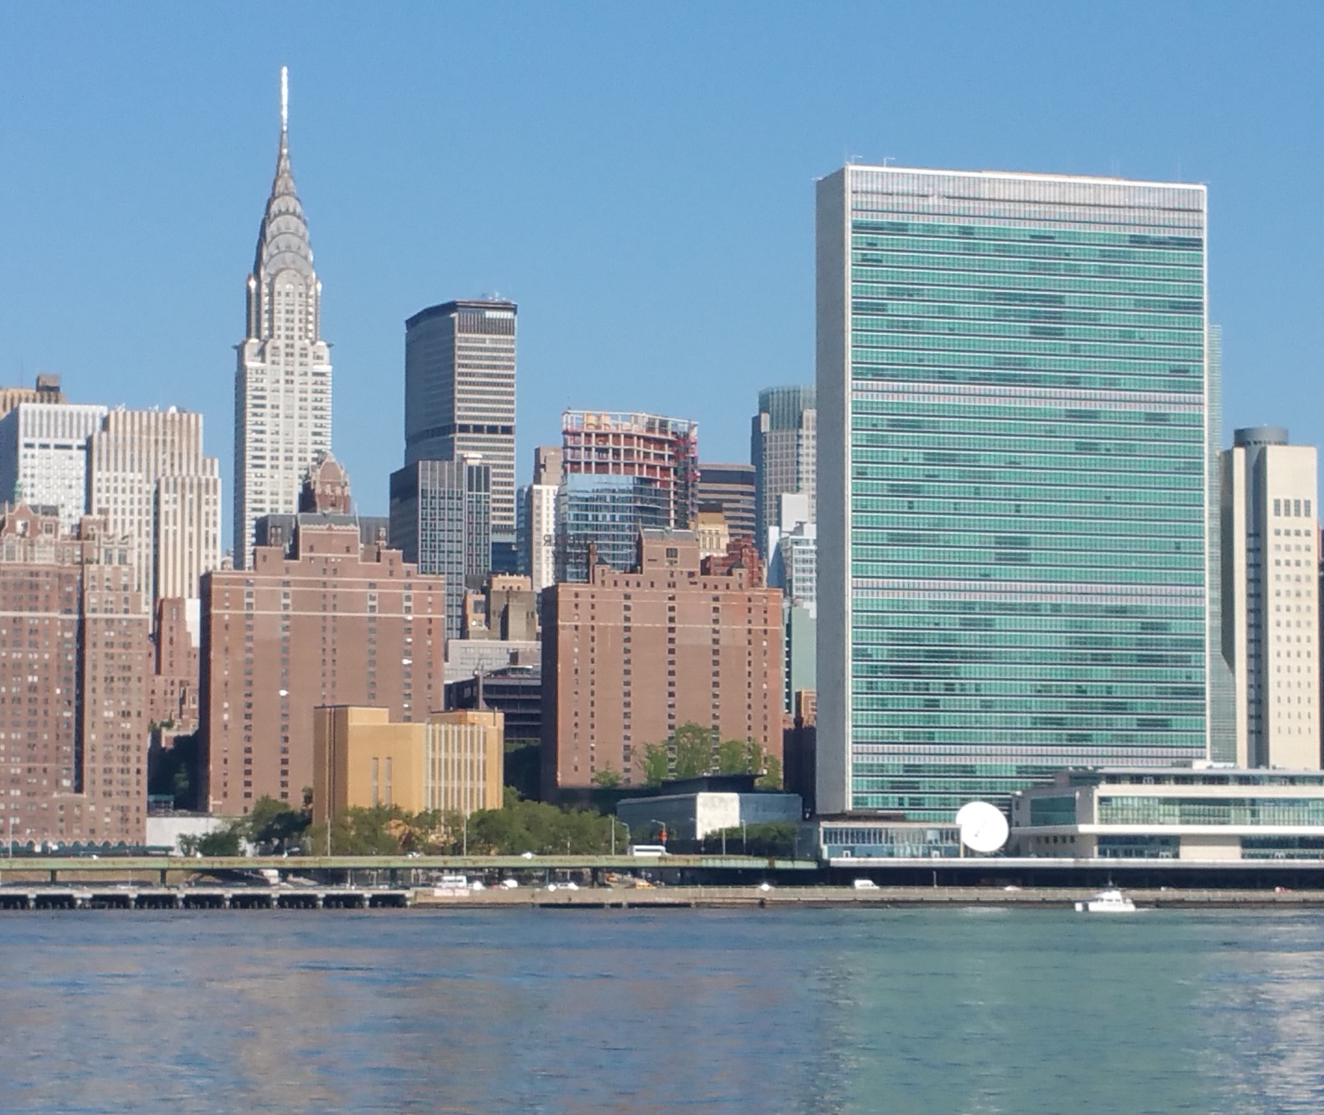
Close up and Personal

Slide 4
Impact of Globalization on Health
Epidemic of heart disease & chronic illness (lifestyle)
Rapid spread of pathogens
Increased marketing to world-wide increasing consumption of high cal, high fat, high sugar foods (diabetes)
Tobacco/Alcohol: adverse long term effects
Substance use disorders (older adults/Baby Boomers)

Slide 5
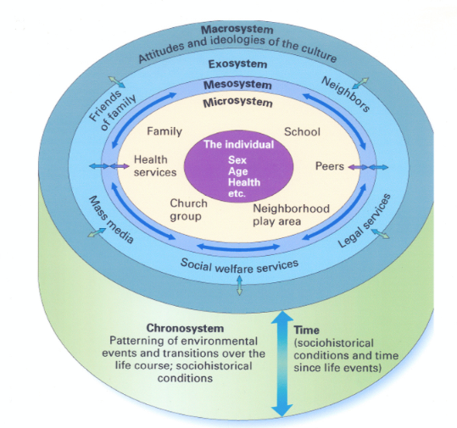

Slide 7

GLOBAL GOALS
People: End poverty and hunger in all forms and ensure dignity and equality
Universal health care
Reduce risk factors
Enhance healthy lifestyles
Promote health & well being
End discrimination of all kinds

Slide 8

Mental Health & NCDs
Major Depression: 3rd largest contributor to global disease burden; expected to become #1 by 2030
Suicide: Claims lives of 800,000 annually; 86% of suicides: low and middle-income countries
Alcohol Abuse: Contributes to 100,000 deaths annually in US (3rd leading cause of death; 20-40% hospital admissions ETOH related)
Dementia: Chronic stress & distress associated with risk of late-life dementia; Depressive episodes associated with increased risk Alzheimer’s disease

Slide 9
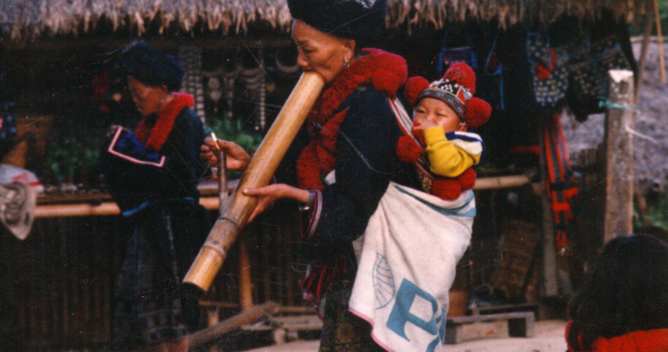

Slide 10
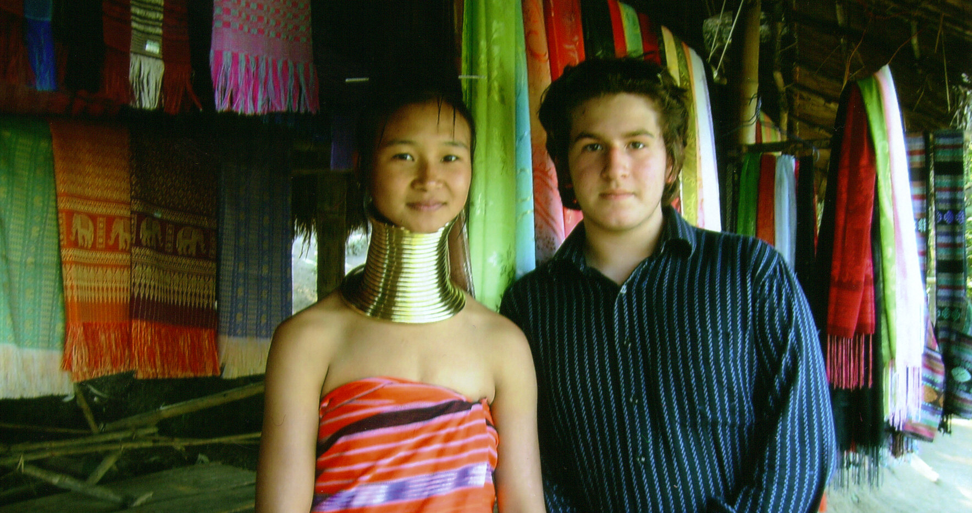

Slide 11


Slide 12
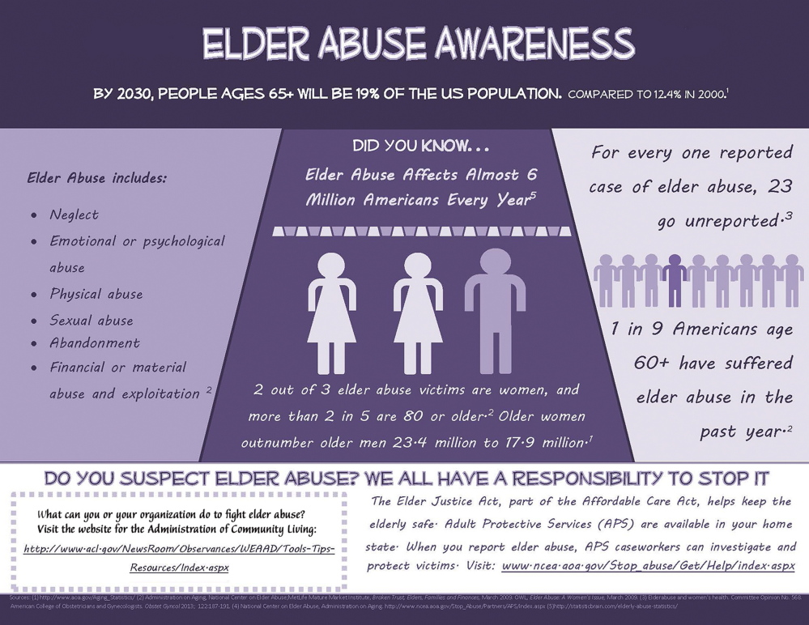

Slide 13
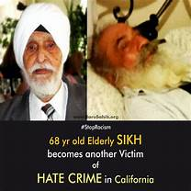
Most Vulnerable Targets of racial, religious, ethnic, violence and Hate Crimes
Sikh
Muslims
Jews
Asians
African Americans
Blacks
Albinos

Slide 14
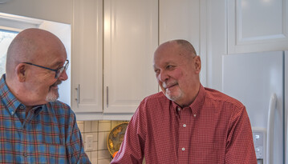
LGBTQ+ Seniors:
In US, Baby Boomers first “out” gen of older. By 2030 number will double
More likely to rely on friends than biological family
More likely to live alone; less likely to have children
9oo million, roughly size of NJ
2009 nearly 50% Senior Centers not welcome LGBT
Receive substandard medical care, provider discrimination
Violence ongoing issue: bullying, harassment, domestic violence, physical violence, murder
vi

Slide 15
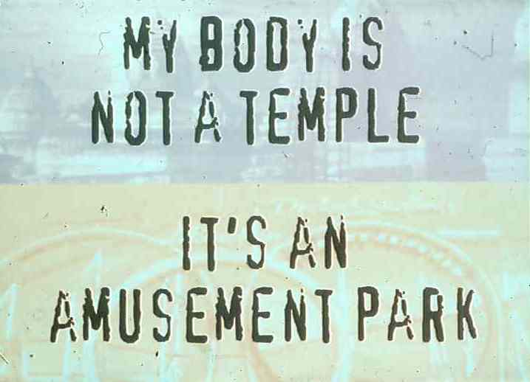

Slide 16
Global Pandemic
Same Turbulent Sea
But not the Same Boat

Slide 17
Exposure to Human Suffering
Vicarious traumatization
Secondary traumatic stress
Compassion fatigue
Burnout

Slide 18

Trauma & Loss
Trauma:
Autonomic nervous system Neurobiological Response
Intrusive stimuli/Avoid re-exposure
Loss:
Recollection; reminiscing
Enduring connections

Slide 19
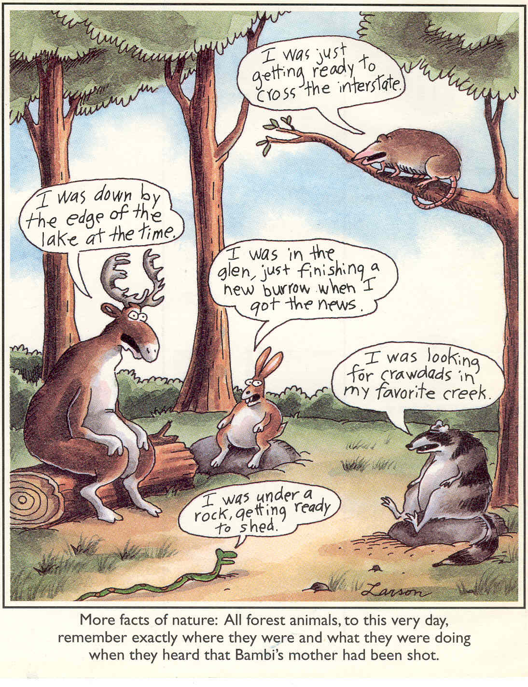

Slide 20
Traumatic Grief
Complicated Grief
Traumatic Grief
Crisis Intervention
PTSD
Impact on growth & development

Slide 21
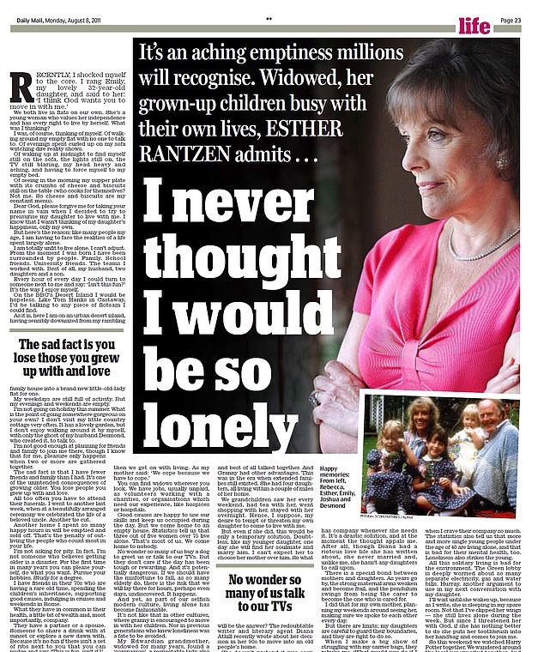
Feelings of distress caused by perceived discrepancy between desired and actual social contact
Loneliness and social isolation more powerful risk to longevity than smoking; increases likelihood of mortality
Associated with: heart disease, malnutrition, poor sleep, cognitive decline, increased hypothalamic pituitary adrenocortical activity, (increased stress hormones), Type 2 diabetes, arthritis, weakened immunity,

Slide 22
GLOBAL GOALS
Prosperity: Ensure prosperous and fulfilling lives in harmony with nature
Freedom from poverty
Access to (reasonable) sources of life-long income
Freedom from excessive medical and health care expenses
Comfortable, healthy life environments

Slide 23


Slide 24
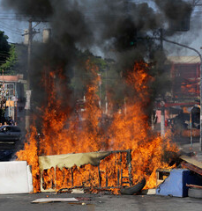
Disasters
Unsafe environments
Community violence
Dangerous Neighborhoods
Safety concerns are risks for depression & dementia

Slide 25
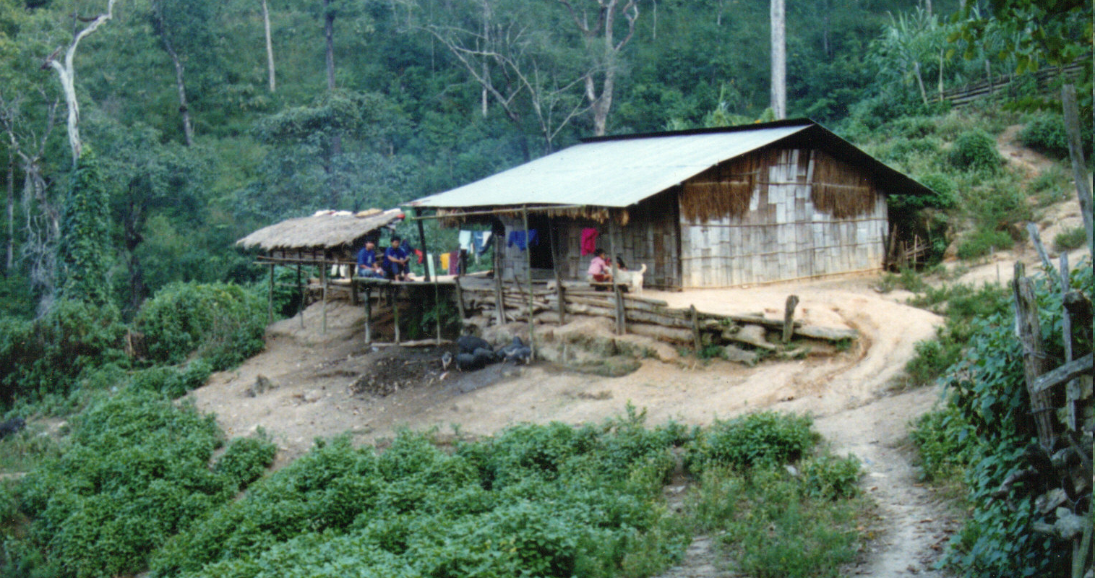

Slide 26
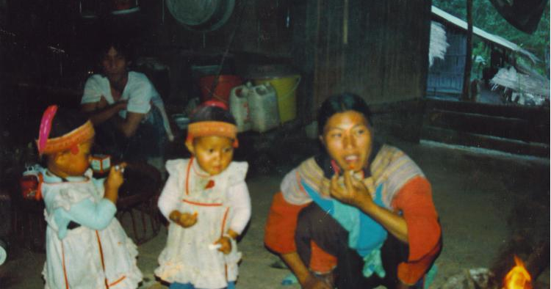

Slide 27
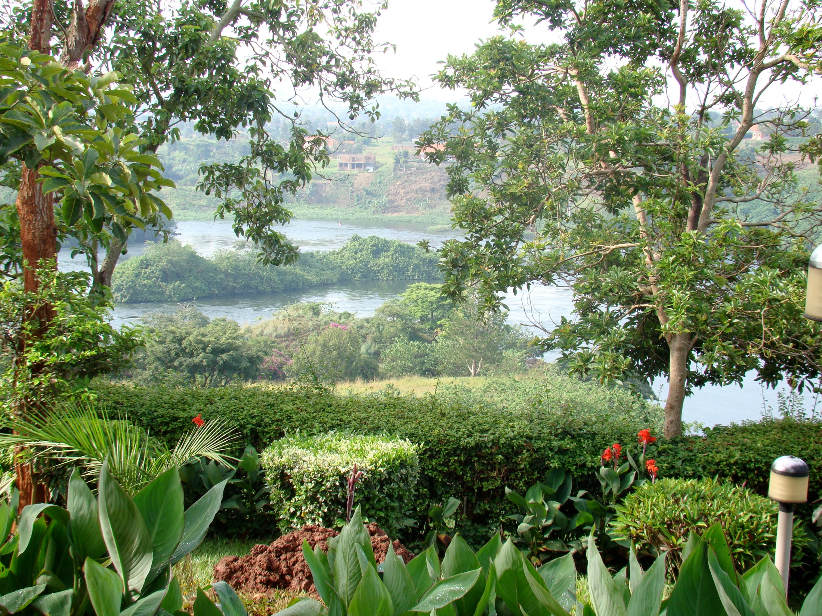
Green Space
Blue Space

Slide 28
GLOBAL GOALS
Peace: Foster peaceful, just and inclusive societies

Slide 29


Slide 31
War Babies
Estimates: tens of thousands of children born during war & conflict
Mass rape campaigns & sexual exploitation during times of war in the last decade alone
These children (many now adults) are deeply affected by the social upheavals that brought about their conception, as well as their treatment by society and stigma on the basis of their biological origins and trauma of their mothers

Slide 32
Sexual violence against women
Biblical descriptionts of rape as a strategy, circumstance, or outcome of war
WHO reports: Higher in some communities, (Western countries: 25%es (US: Native Americans)
Human Trafficking of children now older adults
Historical, institutional violence (US: slavery, indigenous Canada, Australia)
Korean “comfort women”: abducted as sexual slaves following widespread killing and rape of Chinese during Japanese invasions. (WWII)
Mass rape campaigns & sexual exploitation during times of war in North America, Austrailia, Europe, Asia, Africa: China, Bosnia, Korea, Uganda, Republic of Congo

Slide 33
Aim of Terrorism
Traumatize & immobilize population: threats , physical destruction, killing, creation of widespread suffering & chaos.
Survivors: Witnessing murder or catastrophic injury of large numbers of people creates a sense of horror & vulnerability that may last a lifetime.

Slide 34
GLOBAL GOALS
Planet: Protect our planet’s natural resources and climate for future generations
Access to safe surroundings and use of land
Access to clean water and sanitation
Access to comfortable climates and sustainable land masses
Freedom from natural/human made disasters

Slide 35
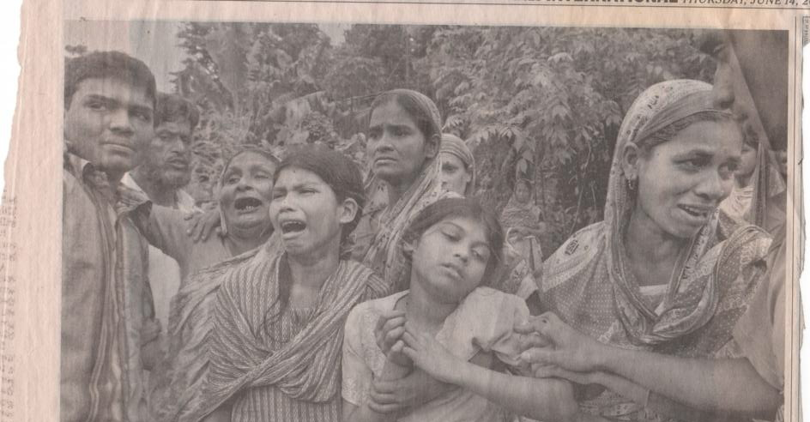

Slide 36
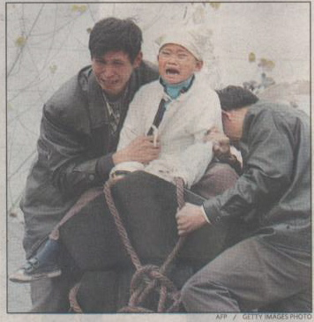

Slide 37
GLOBAL GOALS
Partnerships: Implement the agenda through solid global partnerships
Global partnerships with policy and decision makers
Intersectional, interdisciplinary partnerships
Academic, clinical, research, grass roots
Civil society and multilateral partnerships
Local to global private/public partnerships

Slide 38
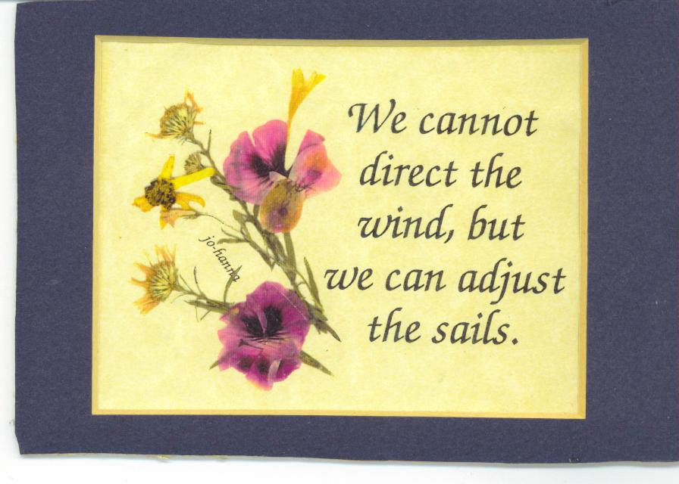

Slide 39

Social Networks
Connections through social networks
Transcend individuals and own limitations
Brains accomplish what no single neuron can do (Christakis & Fowler, 2009)

Slide 40
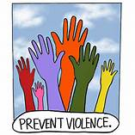
Violence prevention
Individual
Family
Community
Local
Global

Slide 41
International Day for the Elimination of Violence against Women
“Millions of women and girls around the world are assaulted beaten, raped, mutilated or even murdered in what constitutes appalling violations of their human rights…
We must fundamentally challenge the culture of discrimination that allows violence to continue. On this International Day I call on all all governments to make good on their pledges to end all forms of violence against women in all parts of the world, and I urge all people to support this important goal.” Secretary General Ban Ki-moon, Message November 25, 2012

Slide 42
Universal Health Care
All individuals and communities receive the full range of quality health services they need without suffering financial hardship.
Health promotion
Disease prevention
Treatment
Rehabilitation
Palliative Care

Slide 43
Key Priorities
Invest in and Strengthen Primary Health Care
Health Financing
People-centered health systems: Resilient & Sustainable
Strengthen healthcare workforces

Slide 44
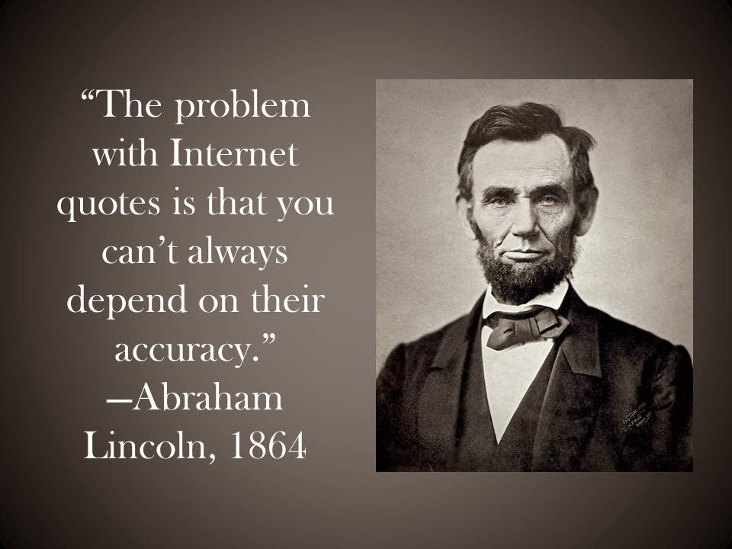

Slide 45


Slide 46
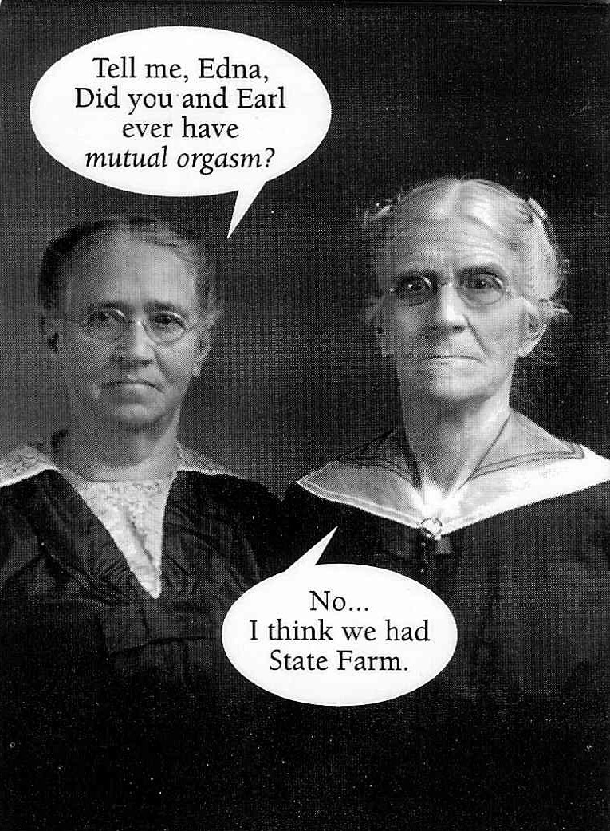

Slide 47
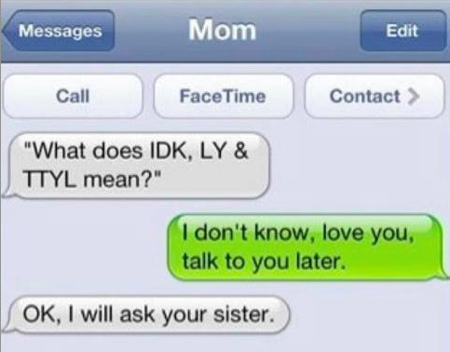

Slide 48
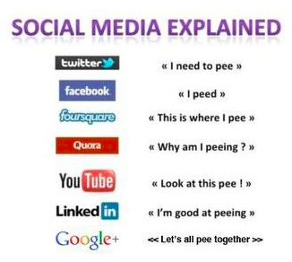

Slide 49
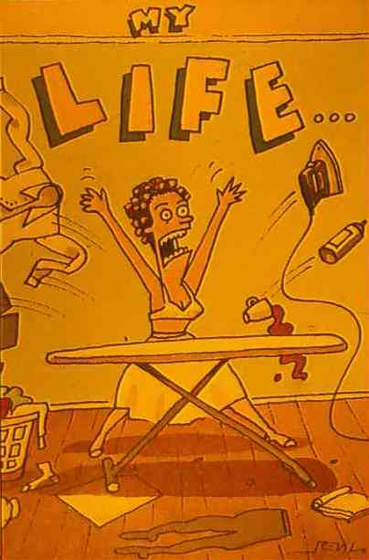

Slide 50


Slide 51
Compassionate Self-Care
If your compassion
does not include yourself,
it is incomplete
Jack Korfield

Slide 52


Slide 53
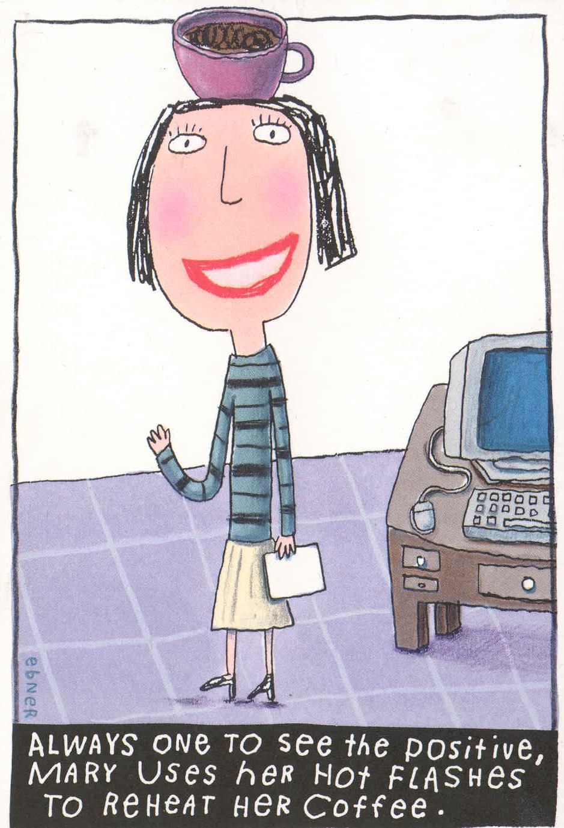

Slide 54
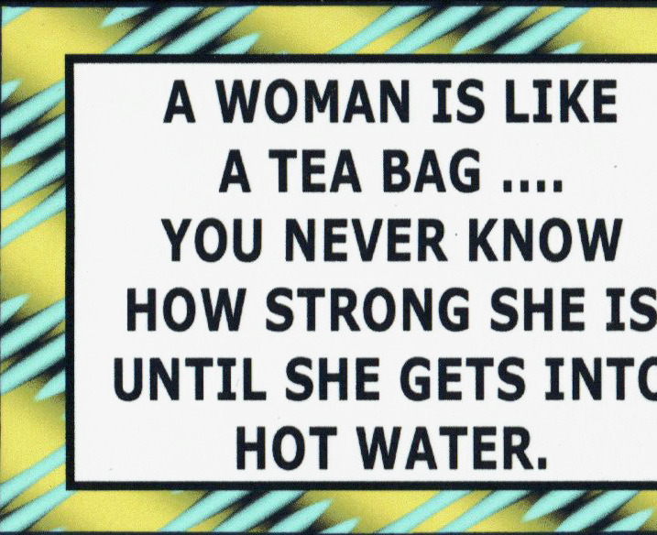

Slide 55

Neuroscience of Altruism
Mirror Neurons : Empathy, Compassion
Compassion and Altruism can be cultivated
Altruism increased engagement of neural systems
Dopaminergic system interacts with oxytocin and vasopressin

Slide 56
Broken Places
“The world breaks everyone and afterwards some are strong at the broken places.”
Ernest Hemingway, A Farewell to Arms

Slide 57
One’s Mind….
…Once stretched by a new idea,
never again retains its original dimension.
                Oliver Wendell Holmes

Slide 58
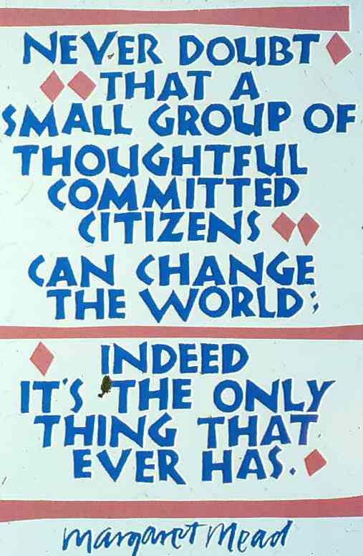

Slide 59
Civil Society
1. Accelerate national implementation
2. Hold Partners accountable to commitments
3. Learn more about goals and how all can contribute

Slide 60
