Slide 1

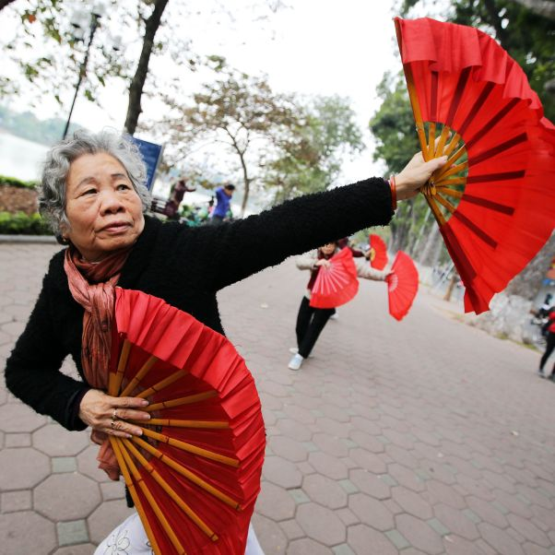
" Reflections on OEWGA and Next Steps”.
UN- Independent Expert on the Enjoyment of all Human Rights by Older Persons
Independent Expert on the enjoyment of all human rights by older persons
NGO Committee on Ageing 04.05.2023

Slide 2
The Human Rights of Older Persons!
Number of older persons will double between 2019 to 2050 globally
Older persons are still not visible in the human rights framework
No specific global human rights instrument on the rights of older persons
Gaps in the current human rights framework and solutions – what is the added value of a convention
UN convention on the rights of older persons will give guidance as other UN Conventions

Slide 3
Mandate of the Independent Expert
Mandated by the Human Rights Council Resolution 24/20 to assess the implementation of existing international human rights instrument relevant for older persons
Identify and adress the promotion of those rights
As well as the gaps and challenges in their realization

Slide 4
Tasks of the Mandate
Two country missions per year
Two thematic reports each year
  - one report to the Human Rights Council – in Geneva
  - one report to the General Assembly – 3rd Committee – in New York
Communication
Comments on legislation and policy

Slide 5
Annual reports | OHCHR
A/75/205: Impact of the coronavirus disease (COVID-19) on the enjoyment of all human rights by older persons
A/HRC/48/53: Report on ageism and age discrimination
A/76/157: Human rights of older women: the intersection between ageing and gender
A/51/27: Report on older persons deprived of their liberty
A/77/239: Older persons and the right to adequate housing - Note by the Secretary-General
Next reports:
  – violence, abuse and neglect of older persons
  – older persons in the context of climate change-induced disasters and building back better

Slide 6
UN Open-ended Working Group on Ageing- https://social.un.org/ageing-working-group/
First session in 2011 – state driven process / General Assembly / NY
Chair: Argentina
Bureau : Canada, Philippines, Nigeria, Slovakia
Secretariat: UN-DESA, OHCHR
12th session in 2022 – cross regional core-group
13th session in 2023 – decision to have two co-facilitators to identify existing gaps and find solutions – working in the intersessional period
– best solution with the best protection and a lot of added values - a dedicated human rights convention for older persons

Slide 7
UN Open-ended Working Group on Ageing-
12th session in 2022 – cross regional core-group
13th session in 2023 – decision to have two co-facilitators to identify existing gaps and find solutions – working in the intersessional period
– best solution with the best protection and a lot of added values - a dedicated human rights convention for older persons
https://social.un.org/ageing-working-group/

Slide 8
Decision:
Two co-facilitators Brasil and Portugal
Working in the intersessional period
Task to come up with an agreed position on the identified gaps in the current human rights framework – present the outcome in the 14th session in 2024

Slide 9
Time for action:
Spread the word of the OEWG-A on the national level and join the session
Inform other key stake holders – collaborate with different groups – intersecting factors should be made visible
Support the co-facilitators
Ask your government how they see the process and their position on drafting a convention on the rights of older persons
Support the work of IE – call for contribution – to thematic reports or in advance of country mission, communication and allegation procedure!
Use UN Days to raise awareness to the human rights of older person

Slide 10


Slide 11
Contact Information
Ms. Claudia Mahler
Independent Expert on the enjoyment of all human rights by older persons
OHCHR-UNOG CH-1211 Geneva 10, Switzerland
Fax: +41 22 917 9006
E-mail: hrc-ie-olderpersons@un.org
Twitter: @IE_OlderPersons

