Slide 1

Bringing “Aging Populations” into the Post-2015 Development Agenda
January 10, 2013

Slide 2

A Strategy for MDGs and Population Aging
Clarity of Goal
  What is it we actually want and why?
Define Stakeholder
Interests
  Governments, Businesses, NGOs, Society…
Data and Information
  What do we have and what do we need?
Make the argument
  What are the benefits? Who will benefit?
  Clearly defined communications and education process (timeline, deliverables)
Planning and Execution

Slide 3
The aging of the global population
is one of the greatest social, economic, and political transformations of our time.

Slide 4
No country is immune.
No person is unaffected.

Slide 5
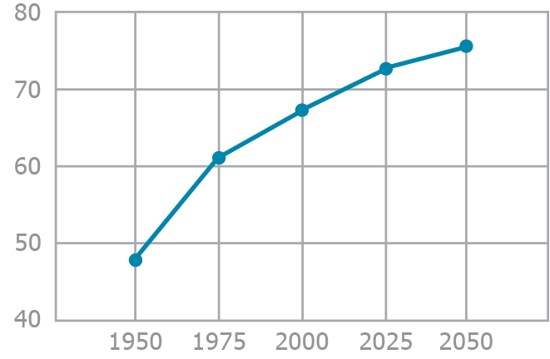
Average Global Life Span Increases by Three Decades
Notes:
Source: UN Population Division

Slide 6
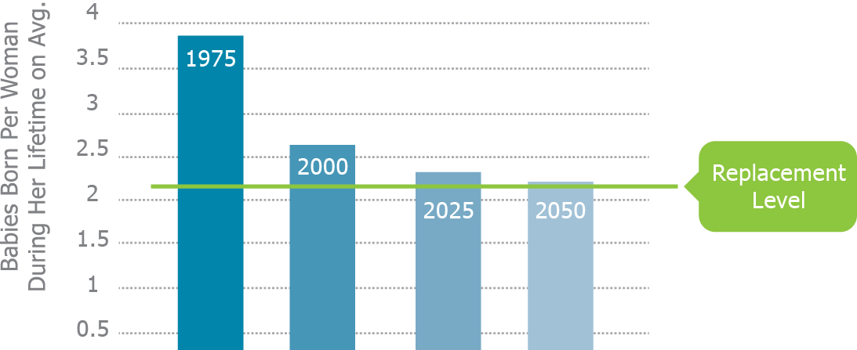
Birth Rates Are Falling Globally

Slide 7
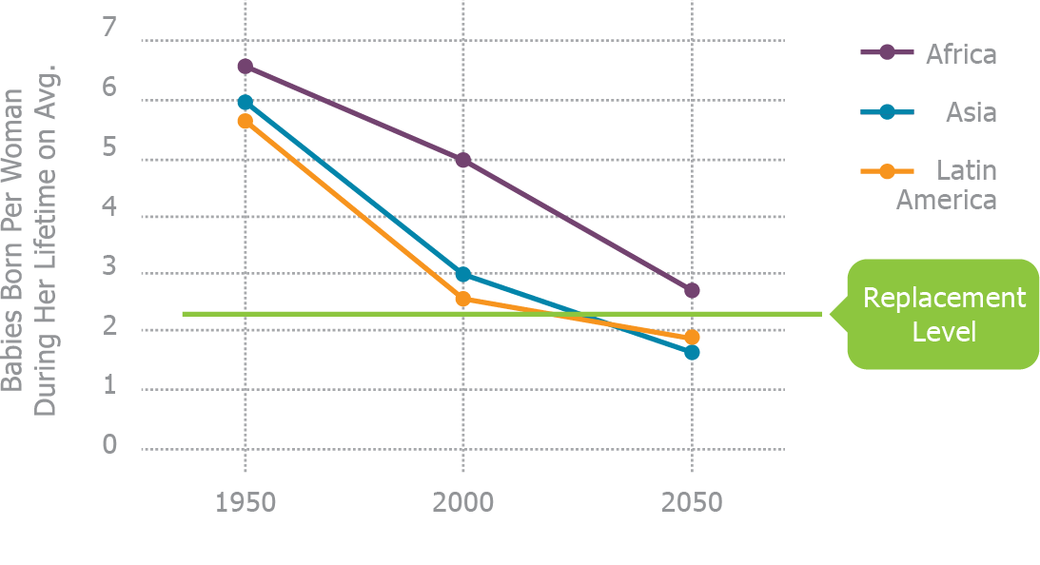
Birth Rates in the Developing World Are Plunging
Notes:
Source: UN Population Division

Slide 8
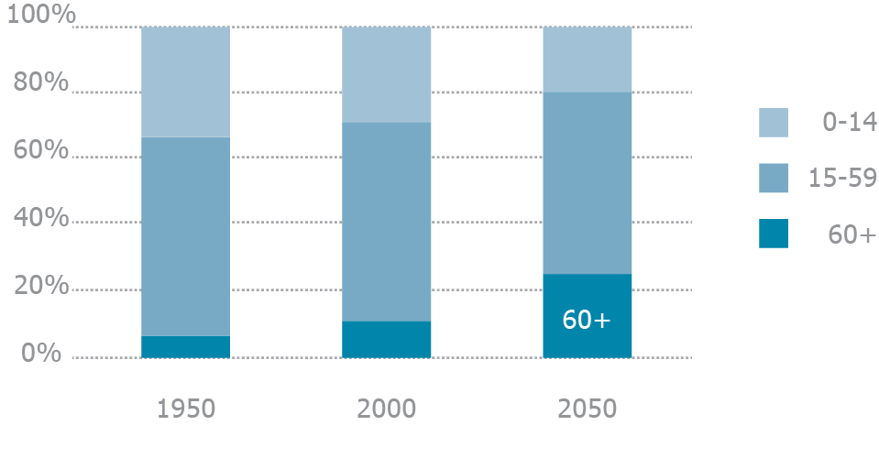
The Percentage of the “Young” Decreases
While the “Old” Steadily Increases
Notes:
Source: UN Population Division

Slide 9
Key Insights…
In our 21st century there is a transformational shift in the proportion of youth to adults across societies globally.
This is a new phenomenon in history, and companies, governments, consumers and stakeholders are increasingly focused on strategies to adapt, compete and win.
Driving lifestyle changes aligned to healthier living, a more active and productive aging and financial security will create an optimistic, energetic and vital approach to 21st century demographic change.

Slide 10

Real, Profound Life-style Changes

Slide 11

Healthy Aging Is a Social and Economic Imperative
Cancer, Diabetes, Alzheimer’s and other non-communicable diseases (NCDs)
to cost $47
trillion by 2030
Major NCDs cost low- and middle-income nations $500 billion annually
NCDs create 4% loss in output over next 20 years
Notes:
Source: The NCD Alliance 13 May 2011 new release, and World Economic Forum, “The Global Economic Burden of Non-Communicable Diseases”

Slide 12
Population aging can be
the 21st century’s greatest failure
or its biggest success.

Slide 13
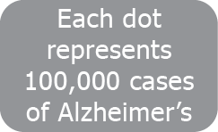
The Number of Alzheimer’s Cases 1900
Notes:
13
Source: WorldMapper.org and Age Wave estimates

Slide 14
The Number of Alzheimer’s Cases 1950
Notes:
14
Source: WorldMapper.org and Age Wave estimates

Slide 15
The Number of Alzheimer’s Cases 2000
Notes:
15
Source: WorldMapper.org and Age Wave estimates

Slide 16
The Number of Alzheimer’s Cases 2050
Notes:
16
Source: WorldMapper.org and Age Wave estimates

Slide 17
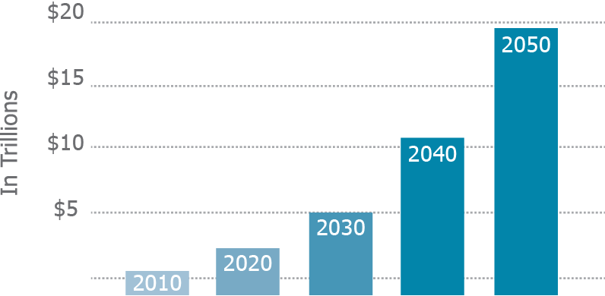
Cumulative Costs of Alzheimer’s Skyrocketing
Notes:
Source: Lewin Trajectory Report, Alzheimer’s Association

Slide 18
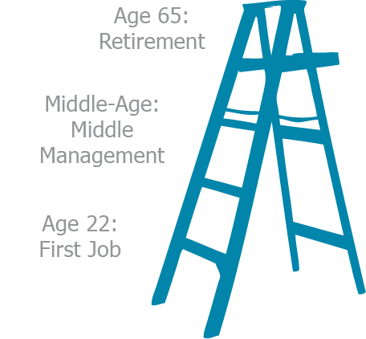
The Career Ladder is Obsolete
Notes:
First job 20, retirement party 65

Slide 19
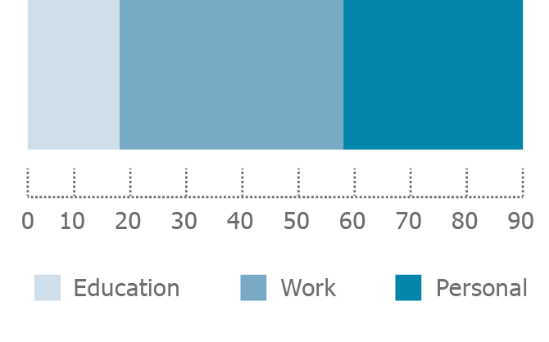

Education Is Front-Loaded in One’s Life

Slide 20
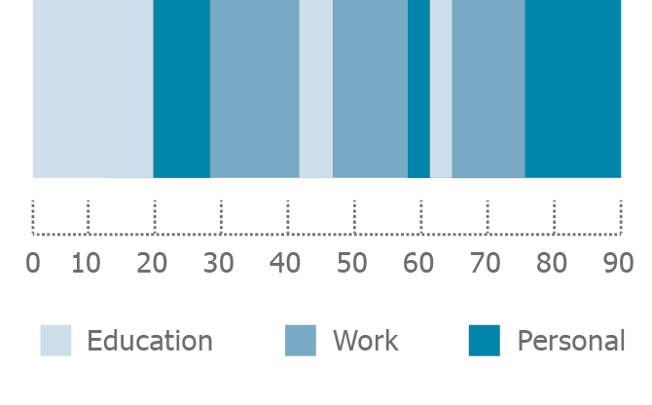
Education Must Become a Life-Long Pursuit

Slide 21

Financial Planning Becomes Far More Complex

Slide 22
It is a CHANGE the world
has never before seen.
Relying on 20th century policies and practices is not an option – for anyone, anywhere.
MDGs are the right structure for the CHANGE required.

