Slide 1

Bethany Brown, JD, Policy Director
HelpAge USA
UN NGO Committee on Aging
Meeting on the Post-2015 Millennium Development Goals
January 10, 2013

Slide 2
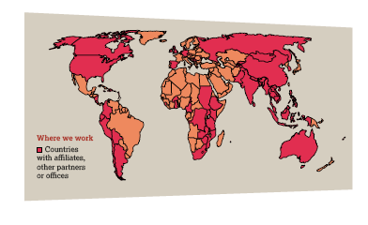

Slide 3
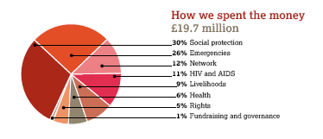
HelpAge Spending by Sector

Slide 4


Slide 5
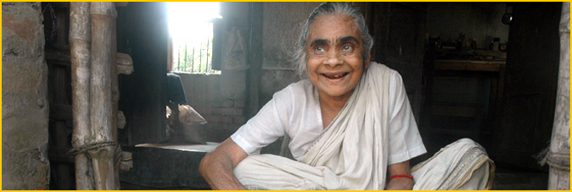
Overview of HelpAge’s Engagement in Post-2015 MDG Process
High-Level Panels
Thematic Consultations
National Consultations
Online Conversation

Slide 6

High-Level Panels
Organizational Meeting, New York, September 2012
London, UK, November 2012
Monrovia, Liberia, January 30-February 2, 2013
Bali, Indonesia, March 2013
Final Meeting, New York, May 2013

Slide 7

Thematic Consultations
Inequalities
Health
Growth and employment
Environmental sustainability
Food security and nutrition
Conflict and fragility
Population dynamics
Education
Governance

Slide 8
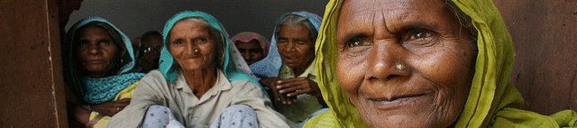
National Consultations
Zambia
Kenya
Moldova
Tanzania
Pakistan
Vietnam
Mozambique
Zimbabwe
Mauritius
China
Indonesia
Thailand
Philippines
Armenia
Tajikistan
Kazakhstan
Fiji
Ethiopia
Ghana
DRC
Burkina Faso
Uganda
South Africa

Slide 9
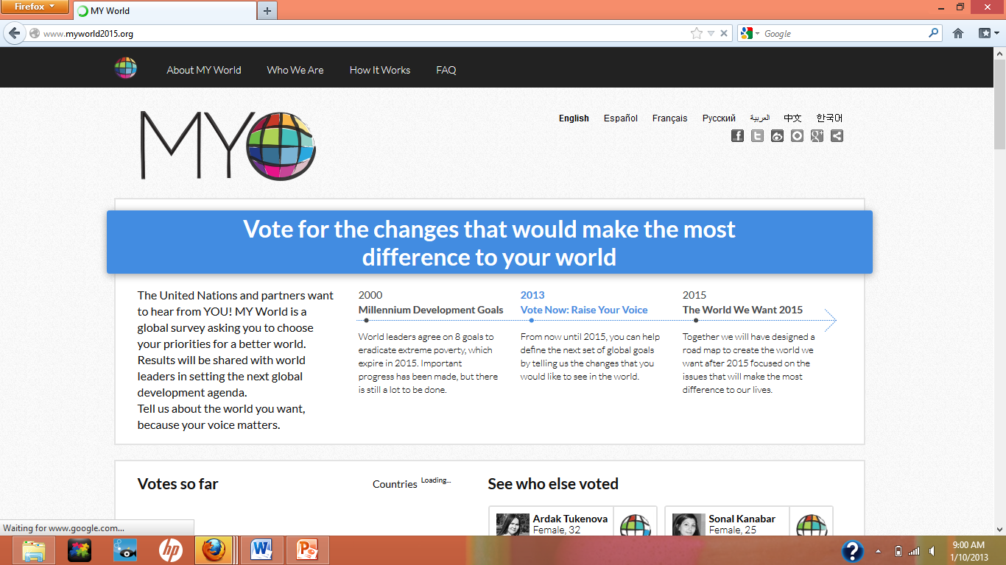
www.MyWorld2015.org

Slide 10

The World We Want 2015:
www.worldwewant2015.org
Beyond 2015
http://beyond2015.org/
Rio +20 Dialogues
http://www.riodialogues.org/
Global AgeWatch Policy Briefs:
http://www.helpage.org/global-agewatch/policy-briefs/

