Slide 1

Building the post 2015 UN Global Development Agenda
What comes after the MDGS?

Slide 3
The Panel co-chairs
H.E. Mr. Susilo Bambang Yudhoyono, President of Indonesia
Co-Chair
H.E. Ms. Ellen Johnson Sirleaf, President of Liberia
Co-Chair
H.E. Mr. David Cameron, Prime Minister of the United Kingdom
Co-Chair
Ms. Amina J. Mohammed
Special Adviser to the SG on Post 2015 Development Planning, ex officio Panel member

Slide 4
➔ The delivery of the new framework is prerogative of the UN Member States, while the UN system’s responsibility is to support Member States in fulfilling this task with evidence-based analysis, knowledge sharing, cross-fertilization of ideas and consensus building.

Slide 5
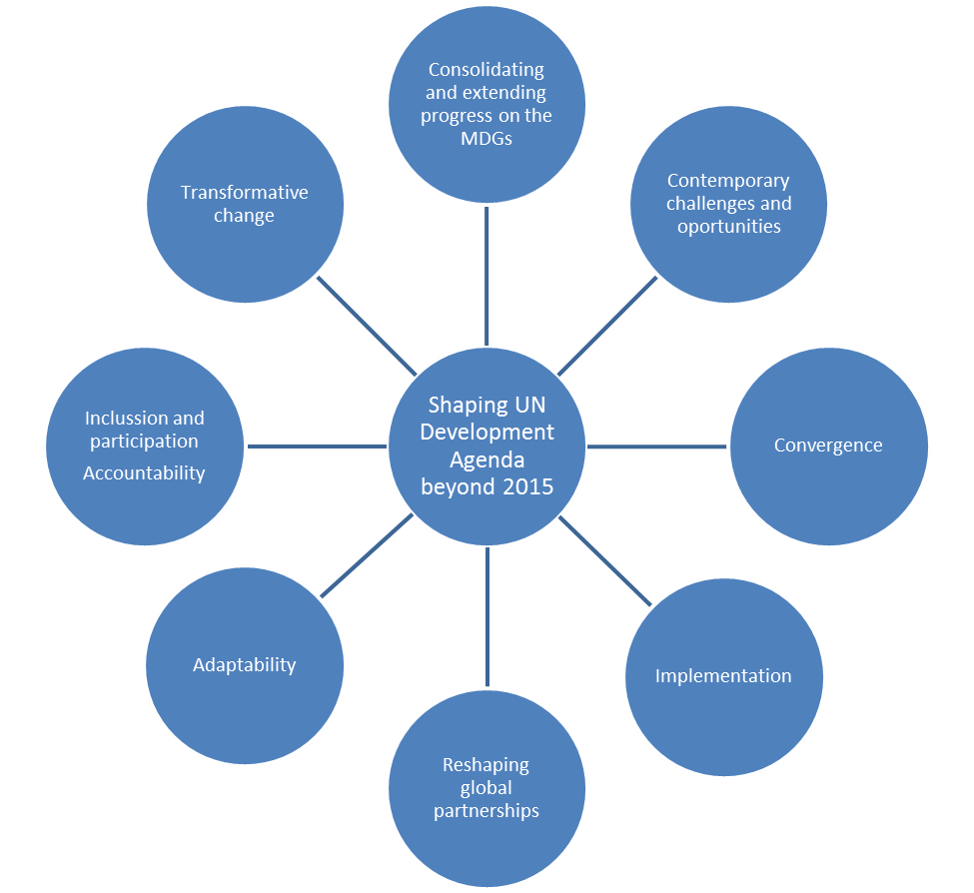

Slide 6
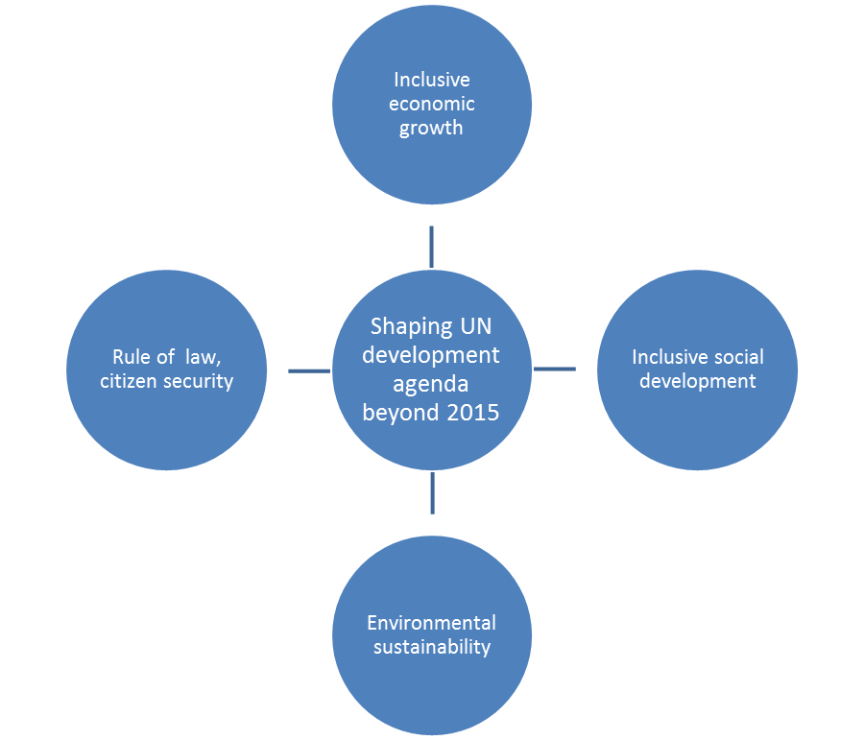

Slide 7
In the past few years ageing and development has gained increasing visibility within the United Nations system. The second review of the implementation of the Madrid International Plan of Action on Ageing, the establishment of the Open-ended working group on ageing by the General Assembly, and the publication of the 2012 “Ageing in the Twenty-First Century, a celebration and a challenge” report have all highlighted the rising relevance of the topic for the work of the UN. In a true inter-agency effort the report, coordinated by UNFPA and HelpAge International, contained inputs from over 20 United Nations entities – including UNDP – and major international organizations and Ban Ki-moon recommended it to a wide global audience noting that “population ageing can no longer be ignored”.

Slide 8
Going forward – issues of older persons in the post-2015 development framework
a. The General Assembly will meet in September 2013 to discuss the post-2015 development framework. The MDGs do not specifically consider the needs and rights of older adults or the contributions they make towards the well-being of their families, communities and the wider economy. Current consultations on the post-2015 framework offer an opportunity to highlight the issue of population ageing. What should be the main focus relative to this area? How can we ensure that the perspectives of older persons are reflected?
b. If the post-2015 framework were to consist of goals and targets, what do you think could be relevant measures to reflect population ageing? What sorts of indicators could be useful to assess progress in this area?
c. How can development policy contribute to the promotion and protection of older people’s rights? How can this be reflected in the post-2015 framework?

Slide 9
SOME USEFUL WEBSITES
http://www.worldwewant2015.org
http://beyond2015.org
http://www.post2015hlp.org
/

